Slide 1
IT Security Controls, Plans and Procedures

Slide 2
Agenda
Schedule for last 4 weeks
Quiz 3 Review
IT Security Controls, Plans, Procedures
Break
Legal and Ethical aspects of computer security

Slide 3
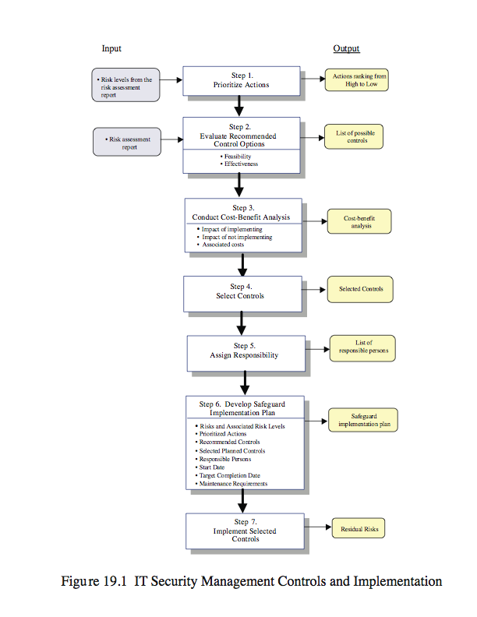
Implementing IT Security Management
Notes:
We continue the examination of IT security management, exploring the range of management, operational and technical controls or safeguards available that can be used to improve security of IT systems and processes. We then explore the content of the security plans that detail the implementation process. These plans must then be implemented, with training to ensure all personnel know their responsibilities, and monitoring to ensure compliance. Finally, to ensure that a suitable level of security is maintained, management must follow up the implementation to evaluate the effectiveness of the security controls and to iterate the entire IT security management process. Details of these steps are illustrated in Figure 17.1 from the text which we now examine further.

Slide 4
Controls or Safeguards
controls or safeguards are
  practices, procedures or mechanisms which may protect against a threat, reduce a vulnerability, limit the impact of an unwanted incident, detect unwanted incidents and facilitate recover
classes of controls:
  management
  operational
  technical
Notes:
Given the results of some form of risk assessment on an organization’s IT systems which identify areas needing treatment, the next step is to select suitable controls to use in this treatment. IT security controls or safeguards (the two terms are used interchangeably) help to reduce risks. [ISO13335] includes the above definition. Some controls can serve to address multiple risks at the same time, and selecting such controls can be very cost effective. Controls can be classified as belonging to one of the following classes (although some controls include features from several of these):
• management control: focus on security policies, planning, guidelines and standards which then influence the selection of operational and technical controls to reduce the risk of loss and to protect the organization’s mission. These controls refer to issues that management needs to address.
• operational: address the correct implementation and use of security policies and standards, ensuring consistency in security operations, and correcting identified operational deficiencies. These controls relate to mechanisms and procedures that are primarily implemented by people rather than systems. They are used to improve the security of a system or group of systems.
• technical controls: involve the correct use of hardware and software security capabilities in systems. These range from simple to complex measures that work together to secure critical and sensitive data, information, and IT systems functions.

Slide 5
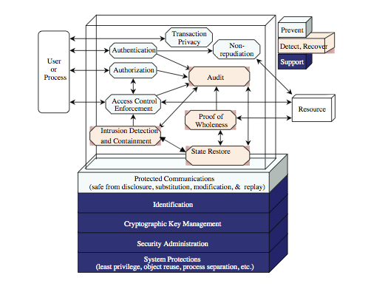
Technical Controls
Notes:
Figure 17.2 (reproduced from Fig 4-3 in [NIST02]) illustrates some typical technical control measures. In turn, each of these control classes may include:
• supportive controls: pervasive, generic, underlying technical IT security capabilities that are interrelated with, and used by many other controls.
• preventative controls: focus on preventing security breaches from occurring, by inhibiting attempts to violate security policies or exploit a vulnerability.
• detection and recovery controls: focus on the response to a security breach, by warning of violations or attempted violations of security policies or the identified exploit of a vulnerability, and by providing means to restore the resulting lost computing resources.
The technical control measures shown in this figure include examples of each of these types of controls. Many of these technical controls relate to topics we discuss elsewhere.

Slide 6
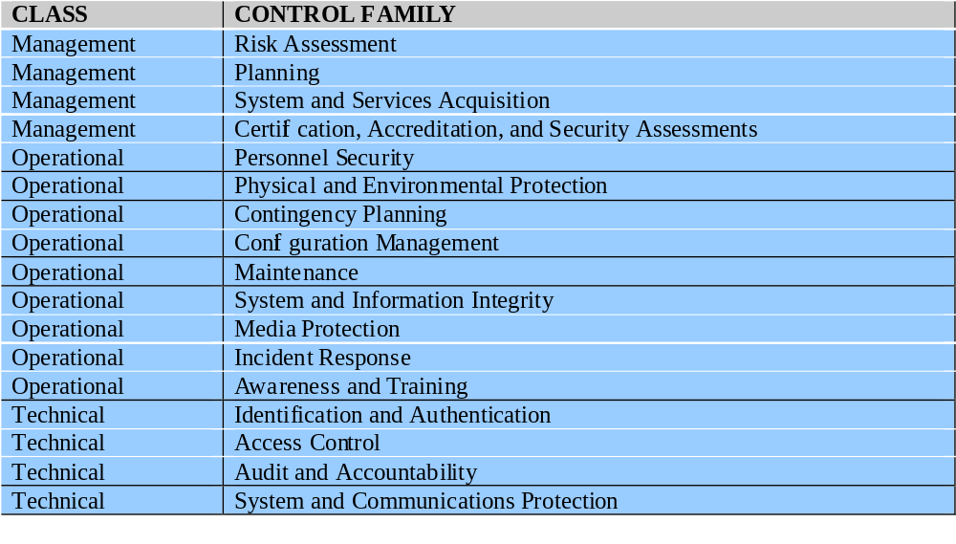
Lists of Controls
Notes:
Lists of controls are provided in a number of national and international standards including [ISO17799], [ISO13335] and [NIST05]. There is broad agreement between these and other standards as to the types of controls that should be used, and the detailed lists of typical controls. Indeed many of the standards cross-reference each other, indicating their agreement on these lists. [ISO17799] is generally regarded as the master list of controls, and is cited by most other standards. Table 17.1 from the text (adapted from table 1 in [NIST05]) is a typical list of families of controls within each of the classes. Within each of these control classes, there is a long list of specific controls that may be chosen. Table 17.3 in the text, which was adapted from the table in Appendix D of [NIST05], itemizes the full list of controls detailed in this standard.
To attain an acceptable level of security, some combination of these controls should be chosen. If the baseline approach is being used, an appropriate baseline set of controls is typically specified in a relevant industry or government standard. For example, Appendix D in [NIST05] lists selections of baseline controls for use in low, moderate and high impact IT systems. A selection should be made that is appropriate to the organization’s overall risk profile, resources and capabilities. If some form of informal or formal risk assessment process is being used, then it provides guidance on specific risks to an organization’s IT systems that need to be addressed. These will typically be some selection of operational or technical controls that together can reduce the likelihood of the identified risk occurring, the consequences if it does, or both, to an acceptable level. These may be in addition to those controls already selected in the baseline, or may simply be more detailed and careful specification and use of already selected controls.

Slide 7
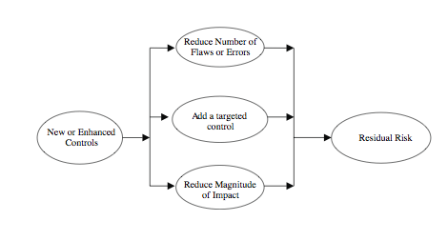
Residual Risk
Notes:
The process illustrated in Figure 17.1 indicates that a recommended list of controls should be made to address each risk needing treatment. The recommended controls need to be compatible with the organization’s systems and policies, and their selection may also be guided by legal requirements. The resulting list of controls should include details of the feasibility and effectiveness of each control. The feasibility addresses factors such as technical compatibility with and operational impact on existing systems, and the likely acceptance by users of the control. The effectiveness equates the cost of implementation against the reduction in level of risk achieved by implementing the control. The reduction in level of risk that results from implementing a new or enhanced control results from the reduction in threat likelihood or consequence that the control provides, as shown here in Figure 17.3 (reproduced from Fig 4-4 in [NIST02]). The reduction in likelihood may result either by reducing the vulnerabilities (flaws or weaknesses) in the system, or by reducing the capability and motivation of the threat source. The reduction in consequence occurs by reducing the magnitude of the adverse impact of the threat occurring on the organization.

Slide 8
Cost-Benefit Analysis
conduct to determine appropriate controls
  greatest benefit given resources available
qualitative or quantitative
show cost justified by reduction in risk
contrast impact of implementing it or not
management chooses selection of controls
considers if it reduces risk too much or not enough, is too costly or appropriate
fundamentally a business decision
Notes:
It is likely that the organization will not have the resources to implement all the recommended controls. Therefore, management should conduct a cost-benefit analysis to identify which controls are most appropriate and provide the greatest benefit to the organization given the available resources. This analysis may be qualitative or quantitative, and must demonstrate that the cost of implementing a given control is justified by the reduction in level of risk to assets that it provides. It should include details of the impact of implementing the new or enhanced control, the impact of not implementing it, and the estimated costs of implementation. It must then assess the implementation costs and benefits against system and data criticality to determine the importance of choosing this control. Management must then determine which selection of controls provides an acceptable resulting level of risk to the organization’s systems. This selection will consider factors if the control:
• reduces risk more than needed, then a less expensive alternative could be used
• cosst more than the risk reduction provided, then an alternative should be used
• not reduce the risk sufficiently, then either more or different controls should be used
• provides sufficient risk reduction, and is the most cost effective, then use it.
It is often the case that the cost of implementing a control is more tangible and easily specified than the cost of not implementing it. Management must make a business decision regarding these ill-defined costs in choosing the final selection of controls and resulting residual risk.

Slide 9
IT Security Plan
provides details of
  what will be done
  what resources are needed
  who is responsible
should include
  risks, recommended controls, action priority
  selected controls, resources needed
  responsible personnel, implementation dates
Notes:
Having identified a range of possible controls, from which management have selected some to implement, an IT security plan should then be created. This is a document that provides details as to what will done, what resources are needed, and who will be responsible. The goal is to detail the actions needed to improve the identified deficiencies in the organization’s risk profile in a timely manner. [NIST02] suggests that this plan should include details of:
• risks (asset/threat/vulnerability combinations)
• recommended controls (from the risk assessment)
• action priority for each risk
• selected controls (on the basis of the cost-benefit analysis)
• required resources for implementing the selected controls
• responsible personnel
• target start and end dates for implementation
• maintenance requirements and other comments

Slide 10
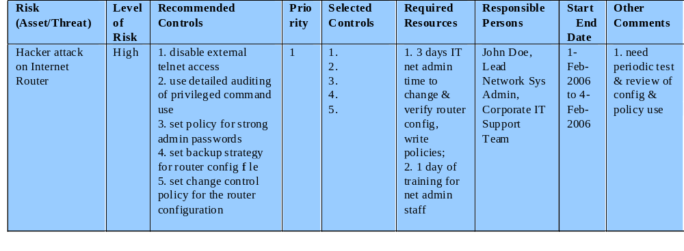
Implementation Plan
Notes:
These details are summarized in an Implementation Plan table, such as that shown here from Table 17.4 in the text. This illustrates an example implementation plan for the example risk identified and shown in Table 16.5. The suggested controls are specific examples of Remote Access, Auditable Event, User Identification, System Backup, and Configuration Change controls, applied to the identified threatened asset. All of them are chosen, since they are neither costly nor difficult to implement. They do require some changes to procedures. The relevant network administration staff must be notified of these changes. They may also require training on the correct implementation of the new procedures, and their rights and responsibilities.

Slide 11
Security Plan Implementation
given plan documents what is required
identified personnel perform needed tasks
  to implement new or enhanced controls
  may need system configuration changes, upgrades or new system installation
  or development of new / extended procedures
  with support from management
monitored to ensure process correct
when completed management approves
Notes:
The next phase in the IT security management process is to manage the implementation of the controls detailed in the IT security plan. The IT security plan documents what needs to be done for each selected control, along with the personnel responsible, and the resources and time frame to be used. The identified personnel then undertake the tasks needed to implement the new or enhanced controls, be they technical, management or operational. This may involve some combination of system configuration changes, upgrades or new system installation. It may also involve the development of new or extended procedures to document practices needed to achieve the desired security goals. Note that even technical controls typically require associated operational procedures to ensure their correct use. The use of these procedures needs to be encouraged and monitored by management. The implementation process should be monitored to ensure its correctness. Usually this is done by the organizational security officer. When the implementation is successfully completed, management needs to authorize the system for operational use. This may be a purely informal process within the organization. Alternatively, especially in government organizations, this may be part of a formal process resulting in accreditation of the system as meeting required standards.

Slide 12
Security Training / Awareness
responsible personnel need training
  on details of design and implementation
  awareness of operational procedures
also need general awareness for all
  spanning all levels in organization
  essential to meet security objectives
  lack leads to poor practices reducing security
  aim to convince personnel that risks exist and breaches may have significant consequences
Notes:
Appropriate security training is an essential component in implementing controls. This training is targeted at the personnel responsible for the development, operation and administration of the system being installed or enhanced. This training may involve details of the design and implementation of technical controls, particularly if these are new or changed significantly from those controls used previously in the organization. It may also involve awareness of details in operational procedures associated with the system, to ensure their correct use.
In addition to specific training relating to particular systems and controls, there is usually also a need for general security awareness training for all personnel in an organization. This program should span all levels in the organization, from senior management down. Such awareness is essential for most organizations to meet their security objectives. Experience shows that a lack of security awareness and associated poor security practices by personnel can significantly reduce the effectiveness of security controls. It has long been recognized that people are often the weakest link in managing security in an organization. The aim of a security awareness program is to convince personnel that significant risks exist to the organization’s IT infrastructure, and that a security breach could have major consequences for the organization.

Slide 13
Security Awareness Issues
organization’s security objectives, strategies, policies
need for security, general risks to organization
understanding why security controls are used
roles and responsibilities for various personnel
the need to act in accordance with policy and procedures, consequences of unauthorized actions
the need to report any security breaches observed and to assist with their investigation
Notes:
The security awareness program should address issues such as:
• the organization’s security objectives, strategies and policies
• the need for security and the general risks the organization is exposed to
• and hence and understanding of why security controls, including technical measures and operational procedures, are used
• the roles and responsibilities for various groups of personnel
• the need to act in accordance with policy and procedures, and the consequences of unauthorized actions
• the need to report any security breaches observed and to assist with their investigation
A wide range of activities and material can be used in such a program. The standards encourage the use of examples of good practice that are related to the organization’s systems and IT usage. Suitable security awareness sessions should be incorporated into the process used to introduce new staff to the organization and its processes. Security awareness sessions should also be regularly repeated to help staff refresh their knowledge and understanding of security issues.

Slide 14
Implementation Followup
security management is cyclic, repeated
need to monitor implemented controls
evaluate changes for security implications
  otherwise increase chance of security breach
have a number of aspects
which may indicate need for changes in previous stages of process
Notes:
The IT security management process does not end with the implementation of controls and the training of personnel. As we noted in Chapter 16, it is a cyclic process, constantly repeated to respond to changes in the IT systems and the risk environment. The various controls implemented should be monitored to ensure their continued effectiveness. Any proposed changes to systems should be checked for security implications, and the risk profile of the affected system reviewed if necessary. Unfortunately this aspect of IT security management often receives the least attention, and in many cases is added as an “afterthought”, if at all. Failure to do so can greatly increase the likelihood that a security failure will occur. This follow up stage of the management process includes a number of aspects which we now examine. Any of these aspects might indicate that changes are needed to the previous stages in the IT security management process. An obvious example is that should a breach occur, such as a virus infection of desktop systems for example, then changes may be needed to the risk assessment, or controls chosen, or the details of their implementation. This can trigger a review of earlier stages in the process.

Slide 15
Maintenance
need continued maintenance and monitoring of implemented controls to ensure continued correct functioning and appropriateness
tasks include:
  periodic review of controls
  upgrade of controls to meet new requirements
  check system changes do not impact controls
  address new threats or vulnerabilities
goal to ensure controls perform as intended
Notes:
The first aspect concerns the continued maintenance and monitoring of the implemented controls, to ensure their continued correct functioning and appropriateness. It is important that someone has responsibility for this maintenance process, which is generally coordinated by the organization’s security officer. The maintenance tasks include ensuring that:
• controls are periodically reviewed to verify they still function as intended
• controls are upgraded when new requirements are discovered
• that changes to systems do not adversely affect the controls
• that new threats or vulnerabilities have not become known
The goal of maintenance is to ensure the controls continue to perform as intended, and hence that the organization’s risk exposure remains as chosen. Failure to maintain controls could lead to a security breach with potentially significant impact on the organization.

Slide 16
Security Compliance
audit process to review security processes
to verify compliance with security plan
using internal or external personnel
usually based on checklists to check
  suitable policies and plans were created
  suitable selection of controls were chosen
  that they are maintained and used correctly
often as part of wider general audit
Notes:
Security compliance checking is an audit process to review the organization’s security processes. The goal is to verify compliance with the security plan. It may be conducted using either internal or external personnel. It is generally based on the use of checklists which check the suitable policies and plans have been created, that a suitable selection of controls were chosen, and that they are maintained and used correctly. This audit process may well be performed as part of a wider, general audit of the organization’s management.

Slide 17
Change and Configuration Management
change management is the process to review proposed changes to systems
  evaluate security and wider impact of changes
  part of general systems administration process
  cf. management of bug patch testing and install
  may be informal or formal
configuration management is keeping track of configuration and changes to each system
  to help restoring systems following a failure
  to know what patches or upgrades might be relevant
  also part of general systems administration process
Notes:
Change management is the process used to review proposed changes to systems, which may can occur for a number of reasons, for implications on the organization’s systems and use. The impact of any proposed change on the organization’s systems should be evaluated. This includes not only security related aspects, but wider operational issues as well. Thus change management is an important component of the general systems administration process. An important example is the constant flow of patches addressing bugs and security failings in common operating systems and applications. If the organization is running systems of any complexity, with a range of applications, then patches should ideally be tested to ensure they don’t adversely affect other applications. This can be a time consuming process that may require considerable administration resources. The change management process may be informal or formal, depending on the size of the organization, and its management processes. In a formal process, any proposed change should be documented and tested before implementation. As part of this process, any related documentation, including relevant security documentation and procedures, is updated to reflect the change.
Configuration management is concerned with specifically keeping track of the configuration of each system in use, and the changes made to each. This includes lists of the hardware and software versions installed on each system. This information is needed to help restoring systems following a failure (whether security related or not), and to know what patches or upgrades might be relevant to particular systems. Again, this is a general systems administration process with security implications, and must interact with IT security management.

Slide 18
Incident Handling
need procedures specifying how to respond to a security incident
  given will most likely occur sometime
reflect range of consequences on org
codify action to avoid panic
e.g. mass email worm
  exploiting vulnerabilities in common apps
  propagating via email in high volumes
  should disconnect from Internet or not?
Notes:
The procedures used to respond to a security incident comprise the final aspect included in the follow up stage of IT security management. The development of such procedures is regarded as an essential control for most organizations. This reflects the reality that most organizations will experience some form of security incident sooner rather than later. Typically most incidents relate to risks with lesser impacts on the organization, but occasionally a more serious incident can occur. The incident response procedures need to reflect the range of possible consequences of an incident on the organization, and allow for a suitable response. By developing suitable procedures in advance, an organization can avoid the panic that can occur when personnel realize that “bad things” are happening, and can thrash around in response, not being sure as to what is the best action. Consider the example of a mass email worm infection of an organization. These typically exploit unpatched vulnerabilities in common desktop applications, and then spread via email to other addresses known to the infected system. The volume of traffic these can generate could be high enough to cripple both intranet and Internet connections. Faced with such an impact an obvious response is to disconnect the organization from the wider Internet, and to perhaps shutdown the internal email system. This decision could however have a serious impact on the organization’s processes, which has to be traded off against the reduced spread of infection. At the time the incident is detected, the personnel directly involved may not have the information to best make such a critical decision about the organization’s operations. A good incident response policy should indicate the action to take for an incident of this severity. It should also specify the personnel who have the responsibility to make decisions concerning such significant actions, and detail how they can be quickly contacted to make such decisions.

Slide 19
Types of Security Incidents
any action threatening classic security services
unauthorized access to a system
  unauthorized viewing by self / other of information
  bypassing access controls
  using another users access
  denying access to another user
unauthorized modification of info on a system
  corrupting information
  changing information without authorization
  unauthorized processing of information
Notes:
There is a range of events that can be regarded as a security incident. Indeed any action that threatens one or more of the classic security services of: confidentiality, integrity, availability, accountability, authenticity and reliability in a system, constitutes an incident. These include various forms of unauthorized access to a system, and unauthorized modification of information on the system.
Unauthorized access to a system by a person includes: accessing information that person is not authorized to see it, accessing information and passing it on to another person who is not authorized to see it, attempting to circumvent the access mechanisms implemented on a system, using another person’s password and user id for any purpose, attempting to deny use of the system to any other person without authorization.
Unauthorized modification of information on a system by a person includes: attempting to corrupt information that may be of value to another person, attempting to modify information and/or resources without authority, processing information in an unauthorized manner.

Slide 20
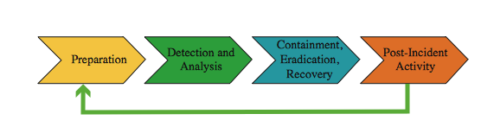
Managing Security Incidents
Notes:
Managing security incidents involves procedures and controls which address:
• detecting potential security incidents
• identifying and responding to breaches in security
• documenting breaches in security for future reference
This process is illustrated here from Figure 17.4 in the text, adapted from figure 3-1 in [NIST06].
Information learnt as a result of a security incident should be used to improve procedures and the risk profile in the future.

Slide 21
Detecting Incidents
reports from users or admin staff
  encourage such reporting
detected by automated tools
  e.g. system integrity verification tools, log analysis tools, network and host intrusion detection systems, intrusion prevention systems
  updated to reflect new attacks or vulnerabilities
  costly so deployed if risk assess justifies
admins must monitor vulnerability reports
Notes:
Security incidents may be detected by users or administration staff, who report a system malfunction or anomalous behavior, and who should be encouraged to make such reports. Security incidents may also be detected by automated tools, which analyze information gathered from the systems and connecting networks, as we discuss in Chapter 6 of the text. Tools that can detect incidents include: system integrity verification tools, log analysis tools, network and host intrusion detection systems, intrusion prevention systems. The effectiveness of such automated tools depends greatly on the accuracy of their configuration, and the correctness of the patterns and signatures used. These need to be regularly updated to reflect new attacks or vulnerabilities. They also need to adequately distinguish between normal, legitimate behavior, and anomalous attack behavior. This is not always easy to achieve, and depends on the work patterns of specific organizations and their systems. However a key advantage of automated systems that are regularly updated, is that they can track changes in known attacks and vulnerabilities. The decision to deploy automated tools should result from the organization’s security goals and objectives, and specific needs identified in the risk assessment process. Deploying these tools usually involves significant resources, both monetary and in personal time. This needs to be justified by the benefits gained in reducing risks. Whether or not automated tools are used, the security administrators do still need to monitor reports of vulnerabilities, and to respond with changes to their systems if necessary.

Slide 22
Responding to Incidents
need documented response procedures
  how to identify cause of the security incident
  describe action taken to recover from it
procedures should
  identify typical categories of incidents and approach taken to respond
  identify management personnel responsible for making critical decisions and their contacts
  whether to report incident to police / CERT etc
Notes:
Once a potential incident is detected, there needs to be documented procedures to respond to it. These procedures need to detail how to identify the cause of the security incident, whether accidental or deliberate. It then needs to describe the action taken to recover from the incident in a manner that minimizes the compromise or harm to the organization. It is clearly impossible to detail every possible type of incident. However the procedures should identify typical categories of such incidents, and the approach taken to respond to them. Ideally these should include descriptions of possible incidents, and typical responses. They should also identify the management personnel responsible for making critical decisions affecting the organization’s systems, and how to contact them at any time when an incident is occurring. The response may involve trading off major loss of functionality against further significant systems compromise. Such decisions will clearly affect the organization’s operations, and must be made very quickly. The response procedures should also identify the circumstances when security breaches should be reported to third parties such as the police or relevant CERT organization. Making such reports clearly helps these third parties monitor the overall level of activity and trends in computer crimes. However, particularly if legal action could be instituted, it may result in a liability on the organization to gather and present suitable evidence.

Slide 23
Documenting Incidents
need to identify vulnerability used
and how to prevent it occurring in future
recorded details for future reference
consider impact on org and risk profile
  may simply be unlucky
  more likely risk profile has changed
  hence risk assessment needs reviewing
  followed by reviewing controls in use
Notes:
Following the immediate response to an incident, there is a need to identify what vulnerability led to its occurrence, and how this might be addressed to prevent it occurring in future. Details of the incident, and the response taken are recorded for future reference. The impact on the organization’s systems, and their risk profile must also be reconsidered as a result of the incident. This typically involves feeding the information gathered as a result of the incident back to an earlier phase of the IT security management process. It is possible that the incident was an isolated rare occurrence, and the organization was simply unlucky for it to occur. More generally though, a security incident reflects a change in the risk profile of the organization that needs to be addressed. This could involve reviewing the risk assessment of the relevant systems, and either changing or extending this analysis. It could involve reviewing controls identified for some risks, and strengthening existing controls, and implementing new controls. This very much reflects the cyclic process of IT security management.

Slide 24
Case Study: Silver Star Mines
given risk assessment, identify controls
  clearly many categories not in use
general issue of systems not being patched or upgraded
plus need for contingency plans
SCADA: add intrusion detection system
info integrity: better centralize storage
email: provide backup system
Notes:
Consider the case study introduced in Chapter 16, which involves the operations of a fictional company “Silver Star Mines”. Given the outcome of the risk assessment for this company, the next stage in the security management process is to identify possible controls. From the information provided during this assessment, clearly a number of the possible controls listed in Table 17.3 of the text are not being used. A comment repeated many times was that many of the systems in use had not been regularly upgraded, and part of the reason for the identified risks was the potential for system compromise using a known, but unpatched vulnerability. That clearly suggests that attention needs to be given to controls relating to the regular, systematic maintenance of operating systems and applications software on server and client systems. Given that potential incidents are possible, attention should also be given to developing contingency plans to detect and respond to such incidents, and to enable to speedy restoration of system function. See text for details on both these points. These controls are generally applicable to all the identified risks, and constitute good general systems administration practice. The top priority risk related to the reliability and integrity of the SCADA nodes and network. Because the traffic to and from the SCADA network is highly structured and predictable, it should be possible to implement an intrusion detection system with much greater reliability than applies to general use corporate networks. The second priority risk related to the integrity of stored information. Clearly all the general controls help ameliorate this risk. This risk would be easier to manage if all documents identified as critical to the operation of the company were stored on a smaller pool of application and file servers. The final risk relates to the availability, integrity and confidentiality of email. For this consideration could be given to a backup email system as part of the contingency planning.

Slide 25
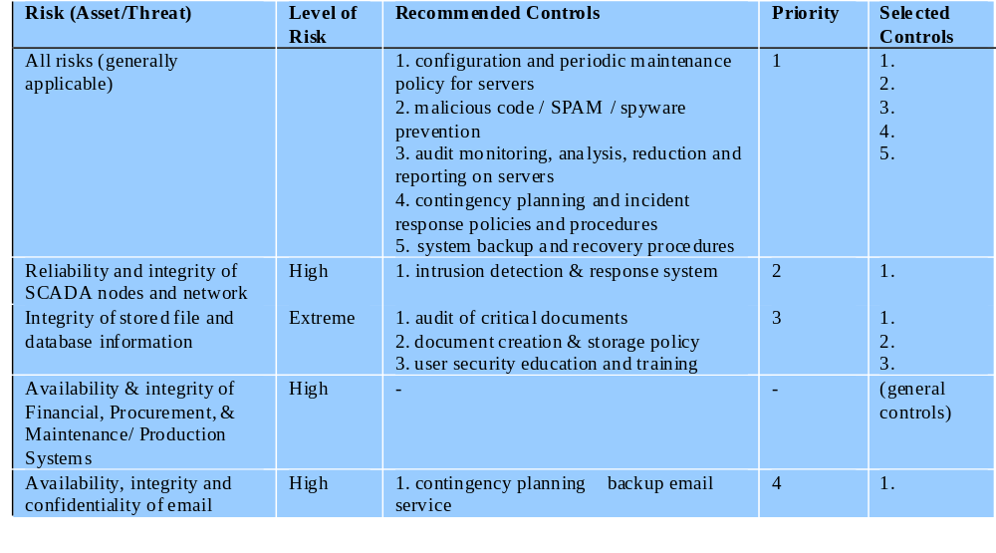
Implementation Plan
Notes:
This analysis of possible controls is summarized here from Table 17.4 in the text. This lists the controls identified, and the priorities on their implementation. This table must then be extended to include details of the resources required, responsible personnel, timeframe and any other comments. This plan would then be implemented, with suitable monitoring of its progress. Its successful implementation leads then to longer term follow-up. This should ensure that the new policies continue to be applied appropriately, and that regular reviews of the companies security profile occurs. In time this should lead to a new cycle of risk assessment, plan development and follow-up.

Slide 26
Summary
security controls or safeguards
  management, operational, technical
  supportive, preventative, detection / recovery
IT security plan
implementation of controls
  implement plan, training and awareness
implementation followup
  maintenance, compliance, change / config management, incident handling
Notes:
Chapter 17 summary.

